Slide 1
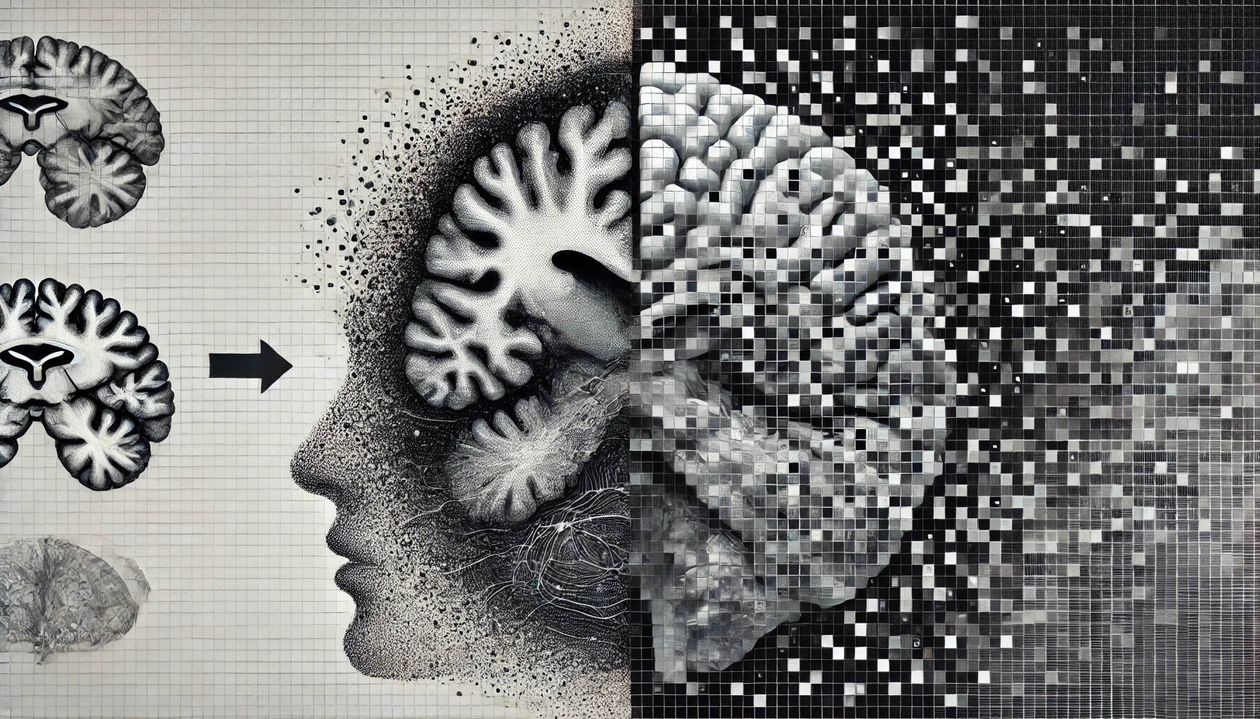

Slide 2
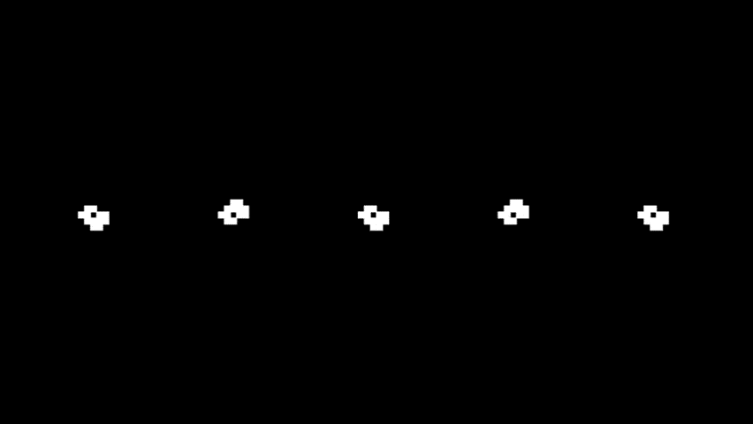


Slide 3

Cellular automata can be trained to recognize patterns, make accurate predictions, and potentially serve as a form of artificial intelligence (AI)

Slide 4
Non-Uniform Elementary Cellular Automata

Slide 5
Non-Uniform Elementary Cellular Automata

Slide 6
Non-Uniform Elementary Cellular Automata

Slide 7
Non-Uniform Elementary Cellular Automata

Slide 8
Non-Uniform Elementary Cellular Automata

Slide 9
Non-Uniform Elementary Cellular Automata

Slide 10
Non-Uniform Elementary Cellular Automata

Slide 11
Non-Uniform Elementary Cellular Automata

Slide 12
Non-Uniform Elementary Cellular Automata

Slide 13
Non-Uniform Elementary Cellular Automata

Slide 14
Non-Uniform Elementary Cellular Automata
=
[0 0 0 1 1 1 1 0]
=
30

Slide 15
Non-Uniform Elementary Cellular Automata
12
144
72
108
205

Slide 16
Learning Cellular Automata

Slide 17
Learning Cellular Automata
Time

Slide 18
Learning Cellular Automata
Ruleset: [25,103,86,204,12,165,149,23,205]
Time

Slide 19
Learning Cellular Automata
Ruleset: [25,103,86,204,12,165,149,23,205]
Input:
12 -> [1 1 0 0]
Problem: number +1
Time
True value:
13: [1 1 0 1]

Slide 20
Learning Cellular Automata
Ruleset: [25,103,86,204,12,165,149,23,205]
Input:
12 -> [1 1 0 0]
Problem: number +1
Time
True value:
13: [1 1 0 1]

Slide 21
Learning Cellular Automata
Ruleset: [25,103,86,204,12,165,149,23,205]
Input:
12 -> [1 1 0 0]
Problem: number +1
Time
True value:
13: [1 1 0 1]

Slide 22
Learning Cellular Automata
Ruleset: [25,103,86,204,12,165,149,23,205]
Input:
12 -> [1 1 0 0]
Problem: number +1
Time
True value:
13: [1 1 0 1]

Slide 23
Learning Cellular Automata
Ruleset: [25,103,86,204,12,165,149,23,205]
Input:
12 -> [1 1 0 0]
Problem: number +1
Time
True value:
13: [1 1 0 1]

Slide 24
Learning Cellular Automata
Ruleset: [25,103,86,204,12,165,149,23,205]
Input:
12 -> [1 1 0 0]
Problem: number +1
Time
True value:
13: [1 1 0 1]

Slide 25
Learning Cellular Automata
Ruleset: [25,103,86,204,12,165,149,23,205]
Input:
12 -> [1 1 0 0]
Problem: number +1
Time
True value:
13: [1 1 0 1]

Slide 26
Learning Cellular Automata
Ruleset: [25,103,86,204,12,165,149,23,205]
Input:
12 -> [1 1 0 0]
Problem: number +1
Time
True value:
13: [1 1 0 1]

Slide 27
Learning Cellular Automata
Ruleset: [25,103,86,204,12,165,149,23,205]
Input:
12 -> [1 1 0 0]
Problem: number +1
Time
True value:
13: [1 1 0 1]

Slide 28
Learning Cellular Automata
Ruleset: [25,103,86,204,12,165,149,23,205]
Input:
12 -> [1 1 0 0]
Problem: number +1
Time
True value:
13: [1 1 0 1]

Slide 29
Learning Cellular Automata
Ruleset: [25,103,86,204,12,165,149,23,205]
Input:
12 -> [1 1 0 0]
Problem: number +1
Time
Predicted value: True value:
[1 0 1 0] 13: [1 1 0 1]
Distance: 3
Fitness: 1/(3 + 1) = 0.25

Slide 30
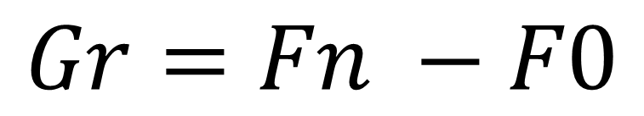
Fitness Growth
$$Gr=Fn −F0$$

Slide 31
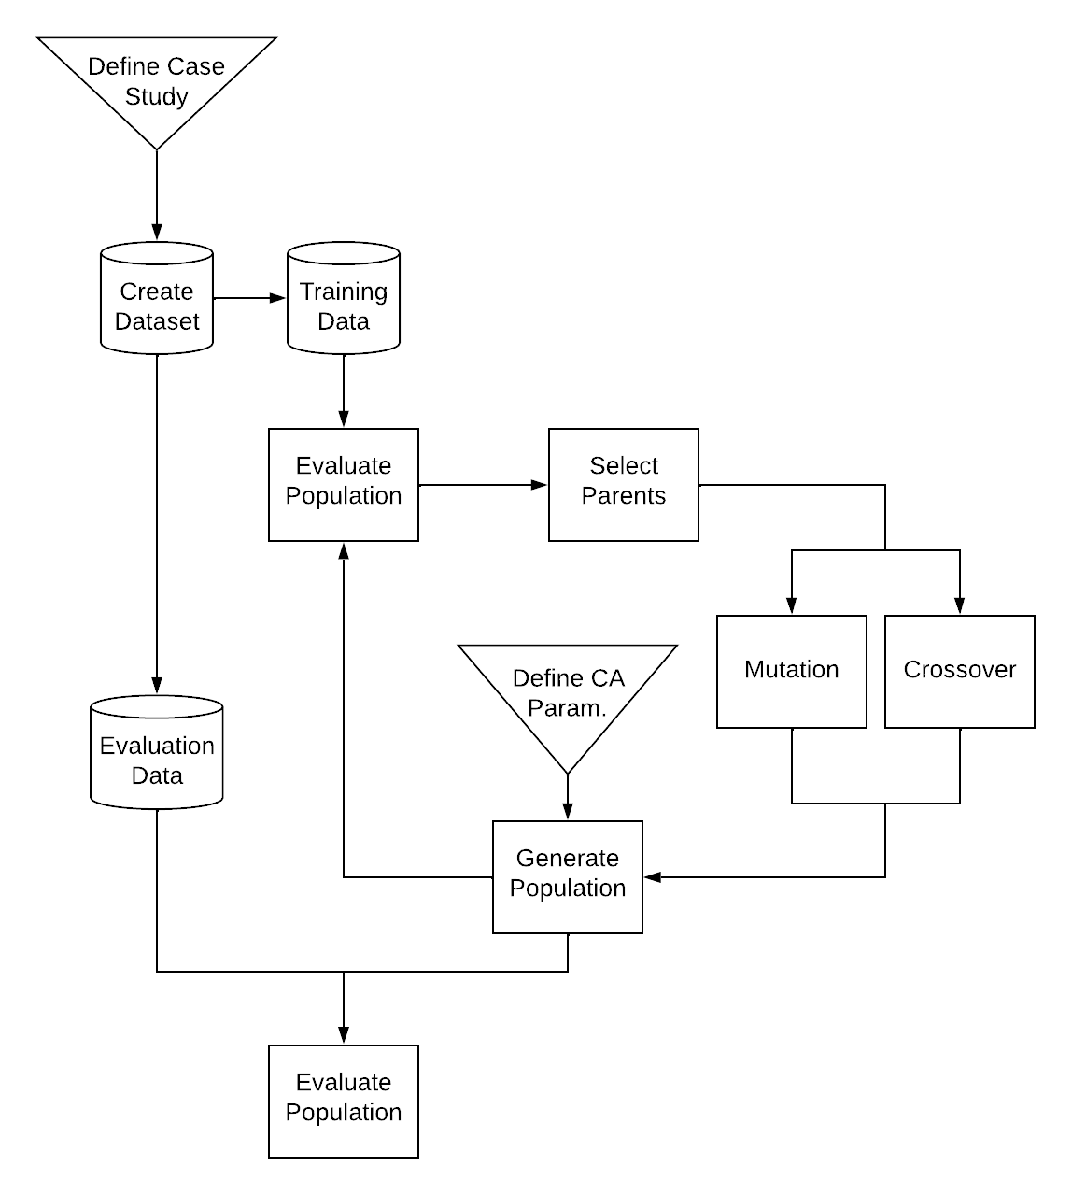
Genetic Algorithms

Slide 32

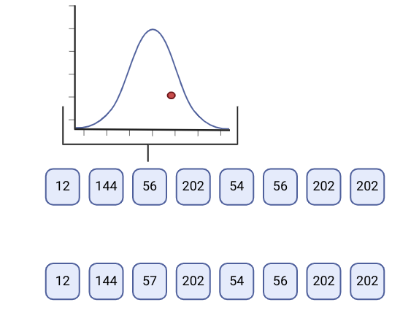
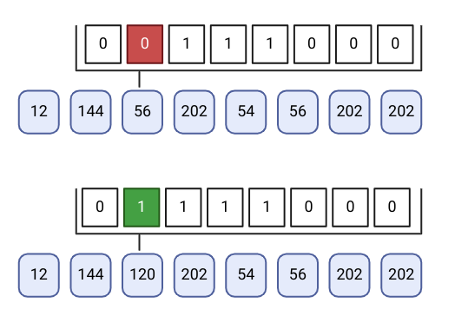
Genetic Algorithms

Slide 33
Genetic Algorithms

Slide 34


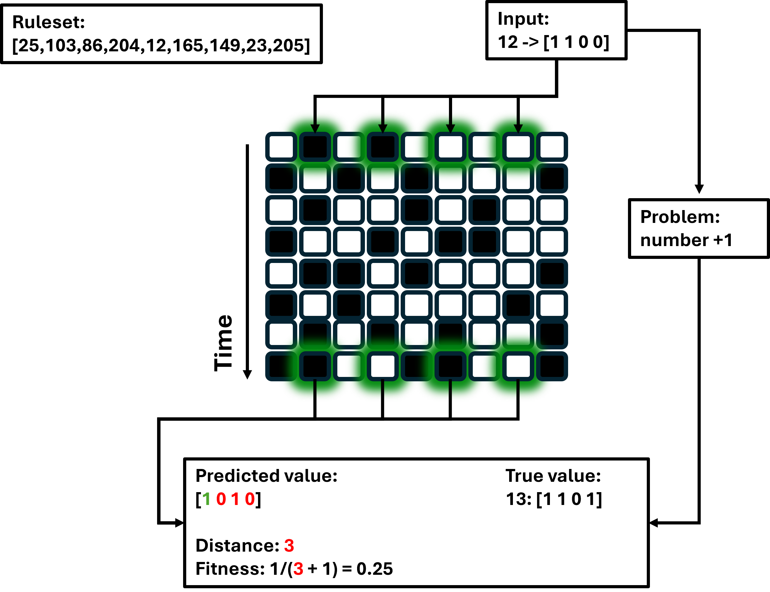
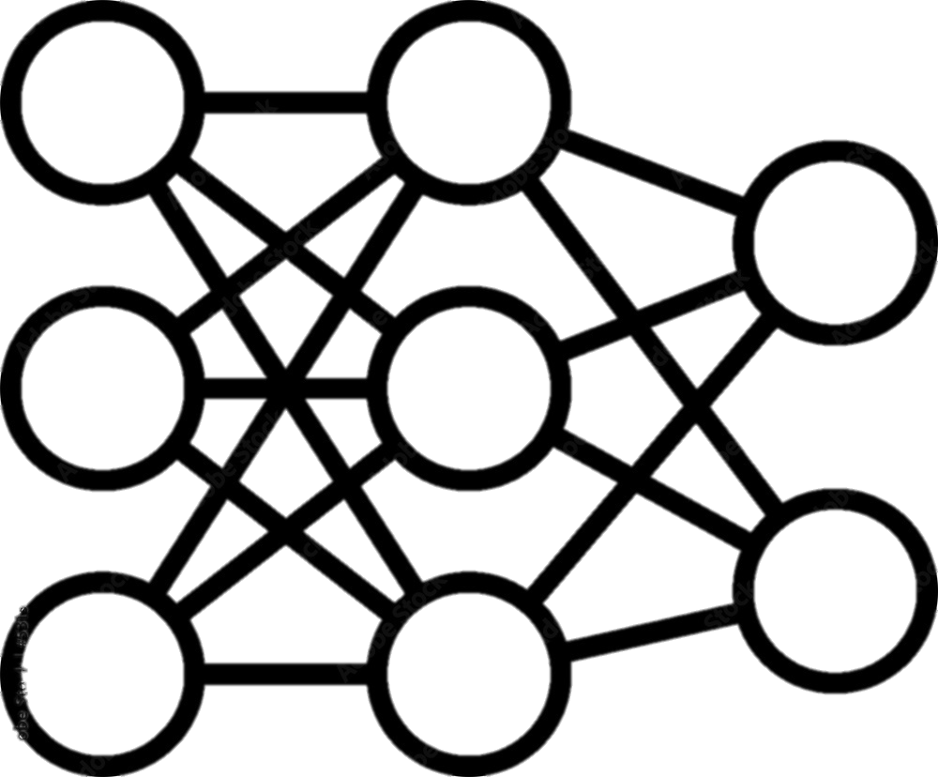
Comparison
VS

Slide 35

Comparison
VS

Slide 36
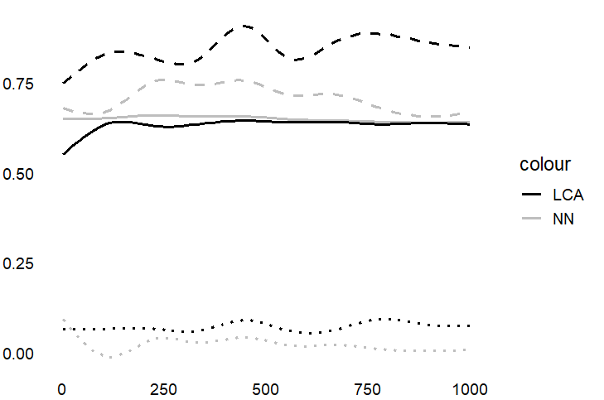
Comparison
Fitness
Runs

Slide 37

Comparison
Fitness
Runs

Slide 38

Comparison
Fitness
Runs

Slide 39
Cellular automata can be trained to recognize patterns, make accurate predictions, and potentially serve as a form of artificial intelligence (AI)

Slide 40
Cellular automata can be trained to recognize patterns, make accurate predictions, and potentially serve as a form of artificial intelligence (AI)
YES*
*with some sidemarks

Slide 42
Comparison
Fitness
Runs

Slide 43
Comparison
Runs
Fitness

Slide 44
Comparison
Fitness
Runs

Slide 45
Comparison
Fitness
Runs
F
F
F
F
F
F
F

Slide 46
Comparison
Fitness
Runs
F
F
F
F
F
F
F
F
F
F
F
F
F
F

Slide 47
Comparison
Fitness
Runs
F
F
F
F
F
F
F

Slide 48
Comparison
Fitness
Runs
F
F
F
F
F
F
F
F
F
F
F
F
F
F
…

Slide 49
Comparison
Runs
Fitness
Ft
Fc

Slide 50
Wine dataset
fixed acidity
volatile acidity
citric acid
residual sugar
Chlorides
free sulfur dioxide
total sulfur dioxide
Density
pH
Sulphates
alcohol
Quality

Slide 51
Wine dataset
fixed acidity
volatile acidity
citric acid
residual sugar
Chlorides
free sulfur dioxide
total sulfur dioxide
Density
pH
Sulphates
alcohol
Quality

